Slide 1
OCR for text detection recognition and identification
Xiangwen & Leihong & Joshua
FDA/NCTR
July 27, 2018

Slide 2
Data prepare: Collecting medicine images
Total images: 5516

Slide 3
Data prepare: Collecting medicine images
Limitation for Crawl from Google Images
100 limit for each search key words
Crawl images in 7 categories:
Allergy relief
Cough relief
Pain relief
Supplement
Vitamins
Skin care
Body care

Slide 4
Data prepare: Collecting medicine images
Search key words for Allergy relief
Allergy Relief, Allergy Medicine, allergy drug, Asthma and Sinus Medicine,
Sunmark allergy medicine, Premier Value allergy, Zyrtec allergy, Claritin allergy
Search key words for Pain relief
headache medicine, pain relief drug, pain relief medicine, pain killer drug, Advil pain relief, Aleve pain relief, Hylands pain relief, Icy Hot pain relief, Premier Value pain relief, Sunmark pain relief, Boiron pain relief

Slide 5
Data prepare: Collecting medicine images
Search key words for Cough relief
Cough Cold medicine, Cough Flu medicine, Cold Flu medicine, cough relief medicine, Vicks cough relief dug, Mucinex cough relief dug, Halls cough relief dug, Theraflu cough relief dug, Premier Value cough relief dug, Sunmark cough relief dug, Alka-Seltzer cough relief dug
Search key words for Supplement
21st Century supplement, Centrum supplement,Mason supplement, Natures Bounty supplement, Natures Truth supplement, Nature Made supplement, Premier Value supplement, Sundance supplement, Sundown Naturals supplement, Sunmark supplement

Slide 6
Data prepare: Collecting medicine images
Search key words for Vitamins
Vitamin b supplement, Vitamin A supplement, Vitamin D supplement, Vitamin E supplement, B complex supplement, Vitamin c supplement, Multivitamins supplement, Calcium supplements, Chromium supplement, Iron supplement, Magnesium supplement, Potassium supplement, Selenium supplement, Zinc supplement
Search key words for Skin care
Anti-Aging cream, Acne cream, Dehydration cream, Sensitive & Redness cream, Daily Care facial cream, Lifting & Firming cream, Creams & Moisturizers, facial Cleansers, Sunscreen cream

Slide 7
Data prepare: Collecting medicine images
Search key words for Body care
Body Lotions, Body Butter, Body Scrubs, body creams, hand creams, Neutrogena body wash, Neutrogena body lotion, Bath & Body Works lotion, Bath & Body Works wash, Bath & Body Works cream, Suave body lotion, Suave body wash, Suave body cream, Olay body lotion, Olay body wash, Olay body cream

Slide 8
Dataset overview:

Slide 9
Similarity Score overview:
Select 10 samples from Allergy Relief category
Compare with all records in 7 categories
Get a 5516x10 matrix

Slide 10
Similarity Score overview:
Cat | Sample1 | Sample2 | Sample3 | Sample4 | Sample5 | Sample6 | Sample7 | Sample8 | Sample9 | Sample10 | Average
allergyRelief | 20.8 | 20.1 | 27.4 | 26.4 | 27.4 | 26.1 | 26.7 | 23.1 | 23.2 | 21.3 | 24.3
bodyCare | 23.7 | 21.4 | 28.5 | 25.2 | 23.5 | 29.1 | 24.6 | 22.9 | 24.4 | 23.3 | 24.7
coughRelief | 18.9 | 15.7 | 28.7 | 23.1 | 22.1 | 29.4 | 24.7 | 18.6 | 20.6 | 17.7 | 22
painRelief | 20.3 | 18.5 | 27.8 | 24.1 | 22.3 | 28 | 24.5 | 19.4 | 21 | 20 | 22.6
skinCare | 22.2 | 19.4 | 27 | 24 | 21.9 | 27.3 | 23.3 | 21.3 | 22.3 | 22 | 23
supplement | 20.1 | 19.3 | 27.6 | 24.8 | 21.8 | 27.2 | 23.5 | 19.9 | 23.3 | 21.6 | 23
vitamins | 21.4 | 19.9 | 27.7 | 24.8 | 22.3 | 27.3 | 23.3 | 21 | 24 | 23 | 23.5

Slide 11
Similarity Score overview:

Slide 12
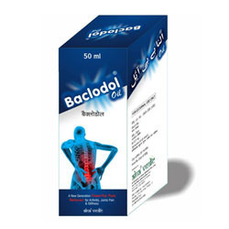

Diagram:
Single Raw Image
Database of all images without text annotation

Slide 13

Diagram:
Single Raw Image
Database of all images without text annotation
Database go through CNN-LSTM pretrained model by Tesseract-OCR

Slide 14
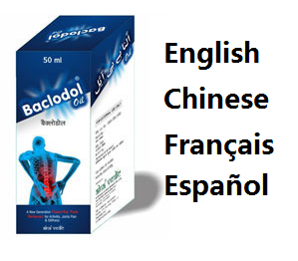

Diagram:
Single Raw Image
Database of all images without text annotation
Database go through CNN-LSTM pretrained model by Tesseract-OCR
Output is Database of all images with text annotation in multi-languages

Slide 15
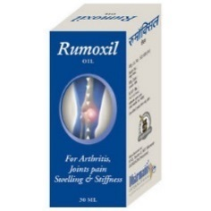
Diagram:
Single Raw Image
Database of all images without text annotation
Test image go through model
Database go through CNN-LSTM pretrained model by Tesseract-OCR
Output is Database of all images with text annotation in multi-languages

Slide 16
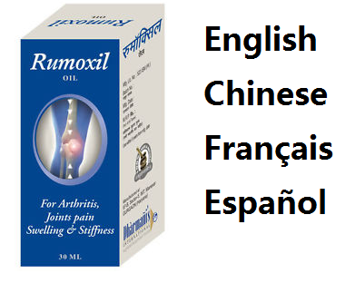
Diagram:
Get annotation
Of test image
Single Raw Image
Database of all images without text annotation
Test image go through model
Database go through CNN-LSTM pretrained model by Tesseract-OCR
Output is Database of all images with text annotation in multi-languages

Slide 17
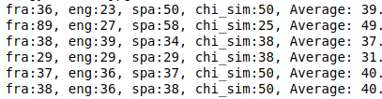
Diagram:
Get annotation
Of test image
Using Partial similarity
Find most similar
One in database
Single Raw Image
Database of all images without text annotation
Test image go through model
Database go through CNN-LSTM pretrained model by Tesseract-OCR
Output is Database of all images with text annotation in multi-languages

Slide 18
Steps:
Build database of 99 raw images without text annotation
Every image go through Tesseract-OCR
Build database of 99 images with text annotation
Input a test image and recognize text
Comparing text of test image with all in database
Get similarity ratio of multi-languages
Output the most similar image in database

Slide 19
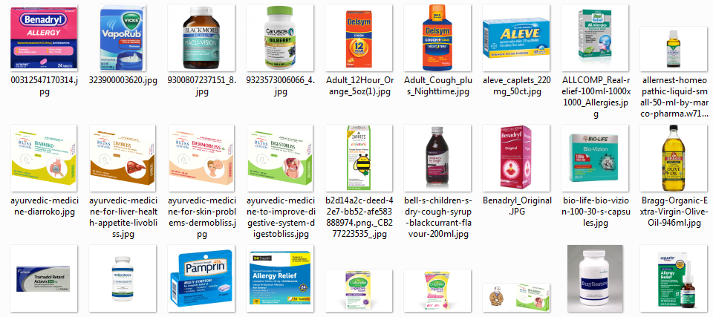
Build database of 99 raw images
We currently have 99 images to build database

Slide 20
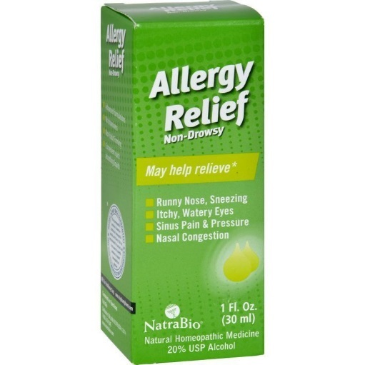
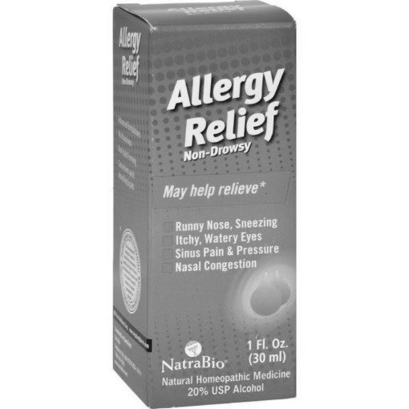
Image go through Tesseract-OCR output is multi-language annotation
French — runny nose, sneezing- itchy, watery eyes© sinus pain & pressurere a c qu[ 1804natrabio (30 ml)rp re an t20% usp alcohol
English --- t al (a r clrlgo c al~ sinus pain & pressureb pr lg[ (n2natrabio (30 ml)natural homeopathic medicine20% usp alcohol
Spanish -- runny nose, sa— ltchy, watery eyes— sinus pain % pressureee5) nanatrabio (enatural homeopathic medicineea
Chinese(sim) --- runny nose, sn6ezing一 ltchy, watery eyes国 eitsedictuuid言 nasal congestiong 0e[20% usp 2

Slide 21
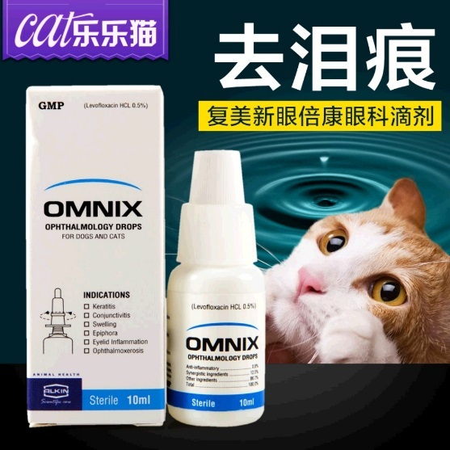
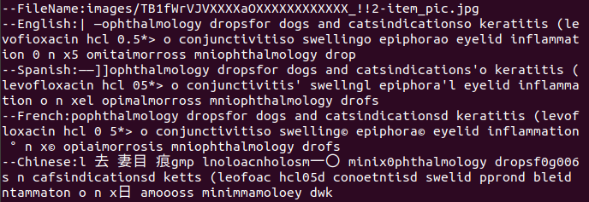
Build database for all images with recognized text annotation
Some sample images with multi-language texts extracted

Slide 22
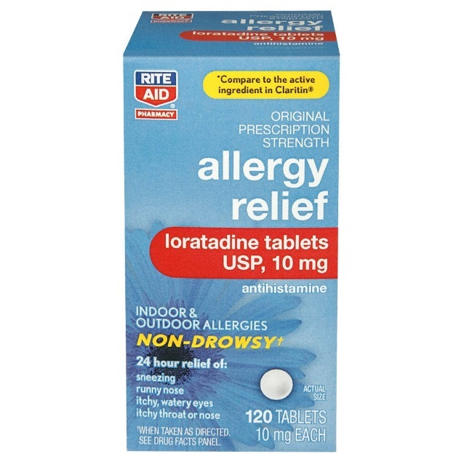

Build database for all images with recognized text annotation
Some sample images with multi-language texts extracted

Slide 23
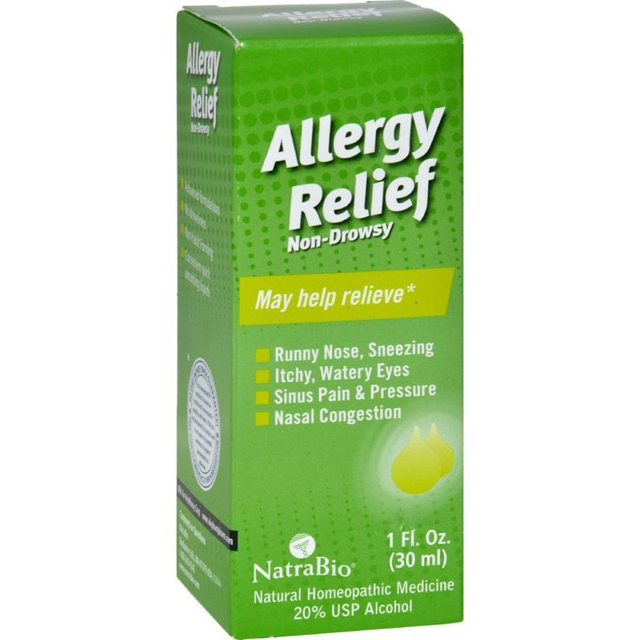
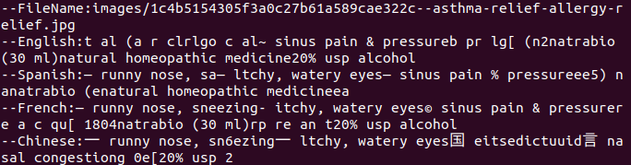
Build database for all images with recognized text annotation
Some sample images with multi-language texts extracted

Slide 24
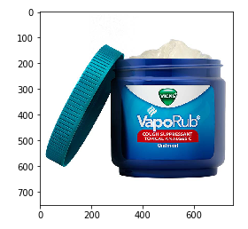
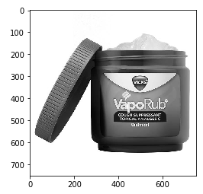
Recognize test image get text annotation
--French: cough suppressant —topical analgesicst
--English: [tv t lt ntopical analgesict
--Spanish: cough suppressant —topical analgesicto
--Chinese: eeointme

Slide 25
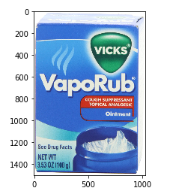
Comparing similarity of input text with database
We comparing extracted text with each records in database.
Get similarity radio (0--100)
Find the Average maximum is 49.75 with the image on the right
fra:89, eng:27, spa:58, chi_sim:25, Average: 49.75
Languages: fra-French, eng-English, spa-Spanish, chi_sim-Chinese

Slide 26
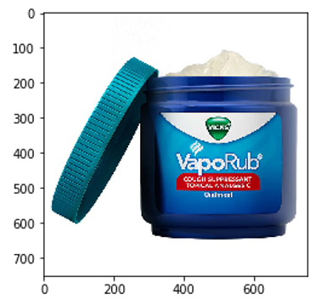
Conclusion
Top 5 with maximum average similarity score
Top 1: Same Brand: VapoRub
Same function: Cough suppressant

Slide 27
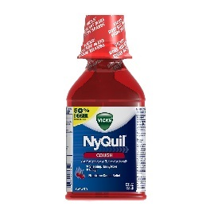
Conclusion
Top 5 with maximum average similarity score
Top 1: Same Brand: VapoRub
Same function: Cough suppressant
Top2: Different Brand: Nyquil
Same function: Cough suppressant

Slide 28
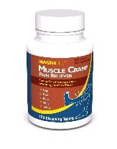
Conclusion
Top 5 with maximum average similarity score
Top 1: Same Brand: VapoRub
Same function: Cough suppressant
Top2: Different Brand: Nyquil
Same function: Cough suppressant
Top3: Different Brand: MAGNILife
Different function: pain relief

Slide 29
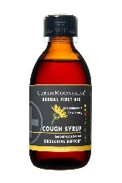
Conclusion
Top 5 with maximum average similarity score
Top 1: Same Brand: VapoRub
Same function: Cough suppressant
Top2: Different Brand: Nyquil
Same function: Cough suppressant
Top3: Different Brand: MAGNILife
Different function: pain relief
Top4: Different Brand: Urban Moonshine
Same function: Cough syrup

Slide 30

Conclusion
Top 5 with maximum average similarity score
Top 1: Same Brand: VapoRub
Same function: Cough suppressant
Top2: Different Brand: Nyquil
Same function: Cough suppressant
Top3: Different Brand: MAGNILife
Different function: pain relief
Top4: Different Brand: Urban Moonshine
Same function: Cough syrup
Top5: Different Brand: Natra bio
Different function: Allergy relief

Slide 31
Conclusion
Top 5 with maximum average similarity score
Languages: fra-French, eng-English, spa-Spanish, chi_sim-Chinese
fra:89, eng:27, spa:58, chi_sim:25, Average: 49.75
fra:38, eng:36, spa:38, chi_sim:50, Average: 40.5
fra:36, eng:23, spa:50, chi_sim:50, Average: 39.75
fra:38, eng:39, spa:34, chi_sim:38, Average: 37.25
fra:32, eng:36, spa:39, chi_sim:38, Average: 36.25

